Slide 1
Teacher Instructions
Print: Slide 9 (1 for every 4 students), Slide 10 (1 for every student)
You’ll need to sign into BBC Sounds to use the podcast:
Brixton: Flames on the Frontline - Episode 1: The Fuse is Lit - BBC Sounds
Only play 3 minutes to 19.41 minutes
Video clip:
Brixton: Flames on the Frontline - Episode 1: The Fuse is Lit - BBC Sounds

Slide 2
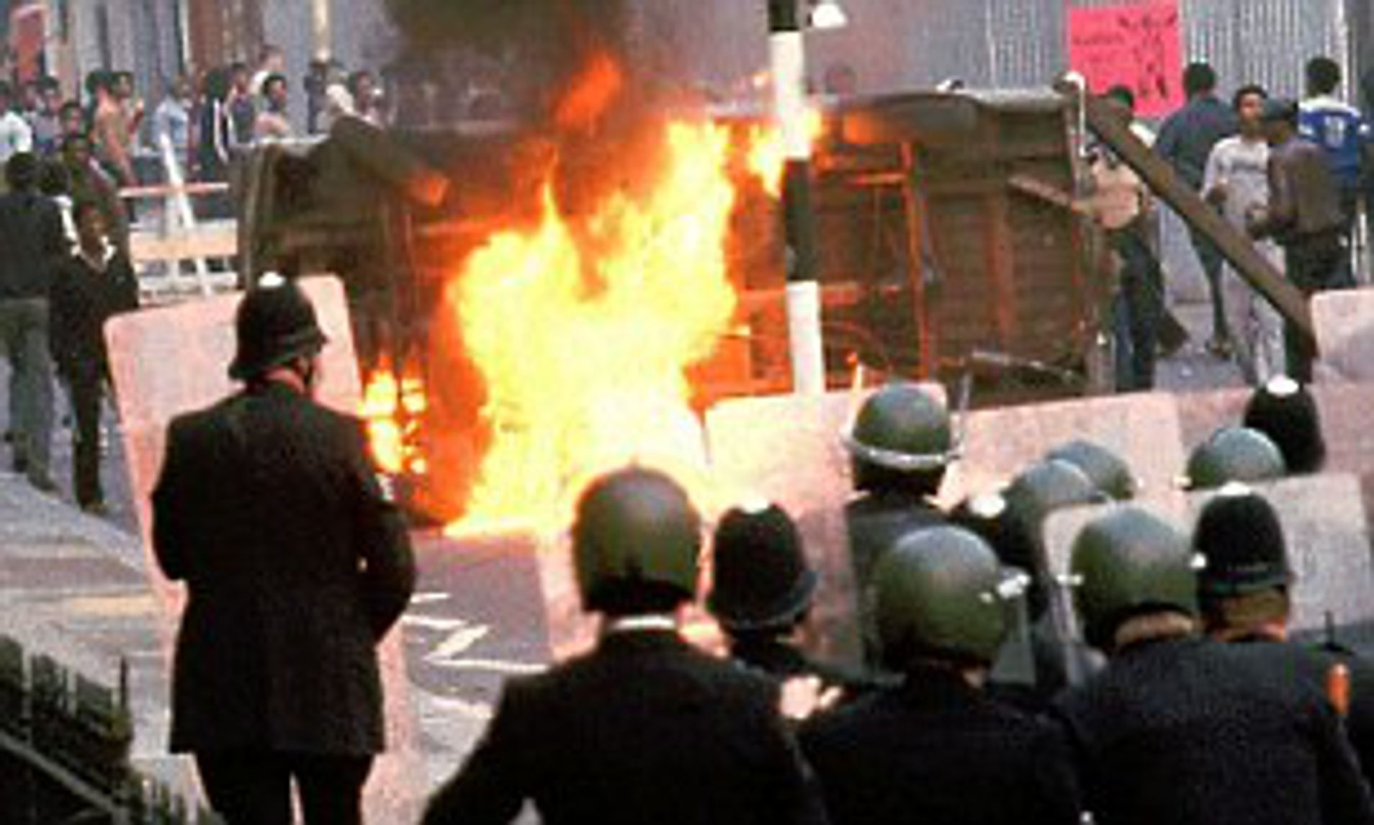
Module 8: Why did Steve McQueen decide to shine a light on the Brixton Uprisings in 2021?
Tuesday, 09 January 2024
Write this module title down and double-underline it. Then stick in the starter sheet and complete the task.

Slide 3
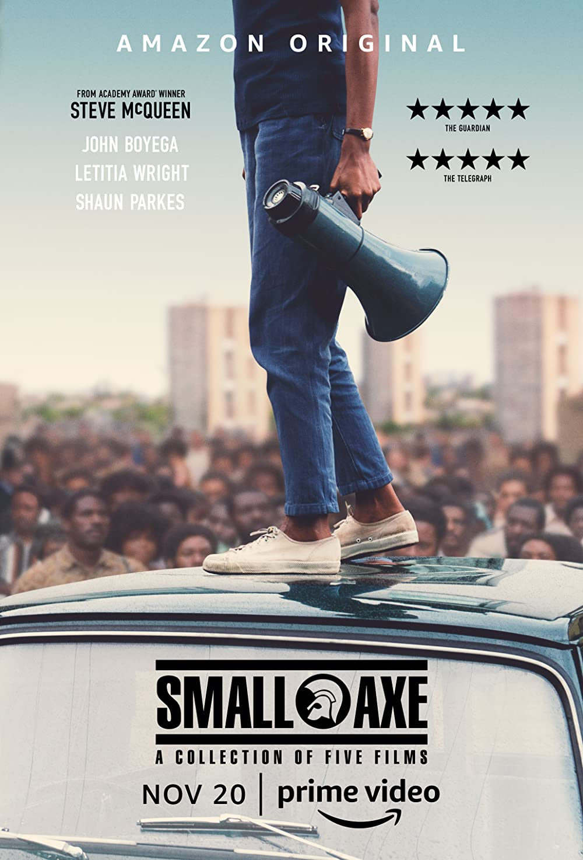
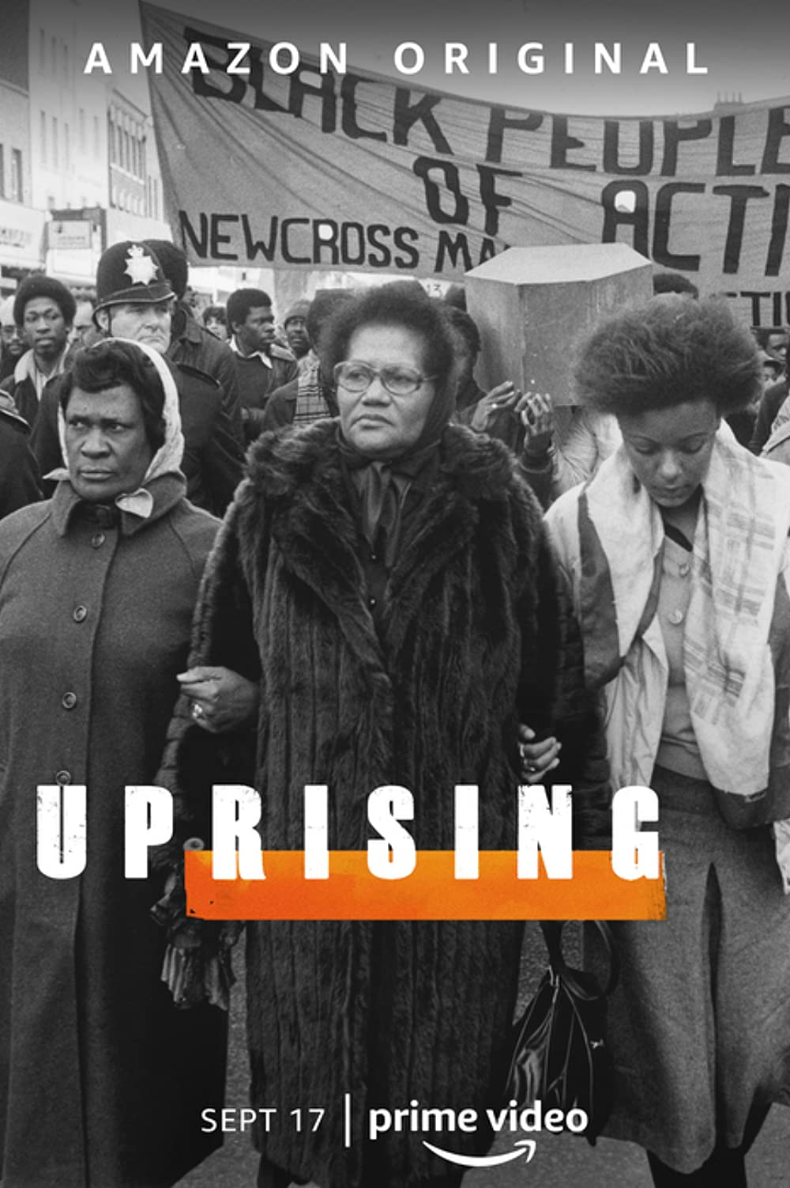
In 2021 the Oscar winning British director Steve McQueen released a series of films telling the story of five key moments in Black British history. He also released an accompanying documentary series called Uprising, which told the story of the 1981 Brixton Uprising. This series won the prestigious title of best documentary series at the 2022 BAFTA awards.
Before the premiere of Uprising Steve McQueen was asked the reason he was desperate to the make the series. This was his response:
‘These events were just pivotal moments and were moments that somehow got brushed under the carpet for the broader, wider public and they needed to come out into the light.
These are historical moments, not just for black British people, but for British people in general because these events have reverberated throughout the nation. We need to shine a light on it [and], we needed to give it the platform it deserved.” (Daily Express interview, 21st July 2021)

Slide 4
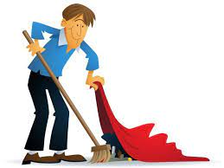
Discussion Point:
What is Steve McQueen saying here?
Moment where society swung/ changed
Come out of hiding
‘These events were just pivotal moments and were moments that somehow got brushed under the carpet for the broader, wider public and they needed to come out into the light.
These are historical moments, not just for black British people, but for British people in general because these events have reverberated throughout the nation. We need to shine a light on it [and], we needed to give it the platform it deserved.” (Daily Express interview, 21st July 2021)
Hidden away
We can still feel the echoes/ pulses of the event
Make it more well known
For nearly 40 years though the Brixton Uprising of 1981 had largely been forgotten by many people in Britain. Why though did Steve McQueen feel it was important to shine a light on the Uprising in 2021. In the next five lessons lessons we’ll find out why as we explore the significance of the event.

Slide 5
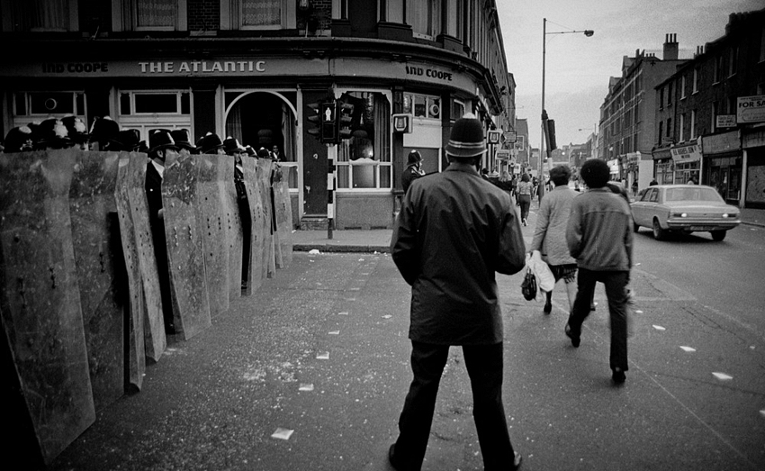
1. Why did Brixton rise up in 1981?
Module 8: Why did Steve McQueen decide to shine a light on the Brixton Uprisings in 2021?
Tuesday, 09 January 2024
Lesson Objectives
Outline the causes and events of the 1981 Brixton Uprising.

Slide 6
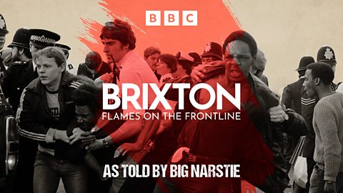
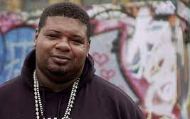
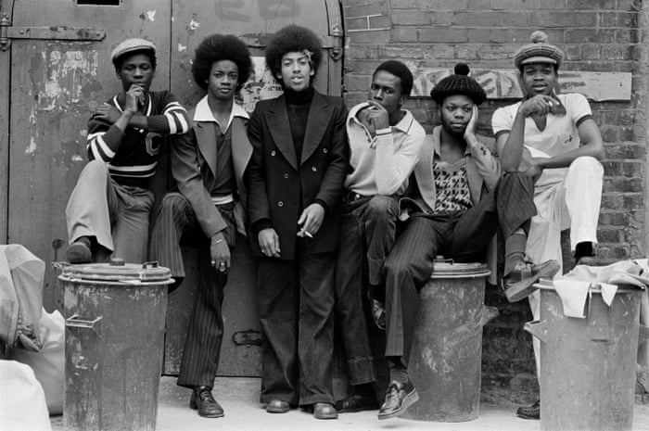
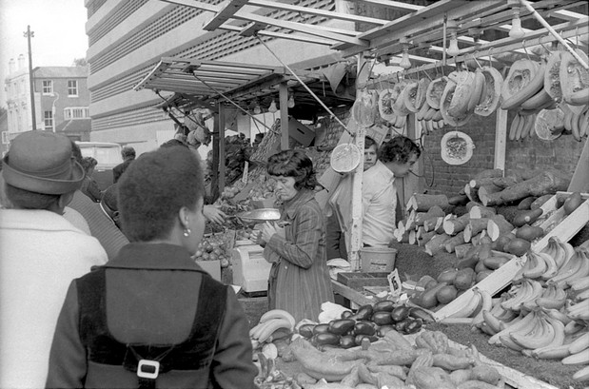
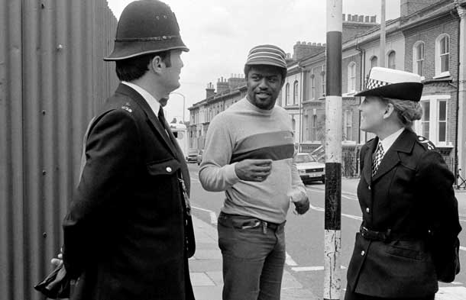
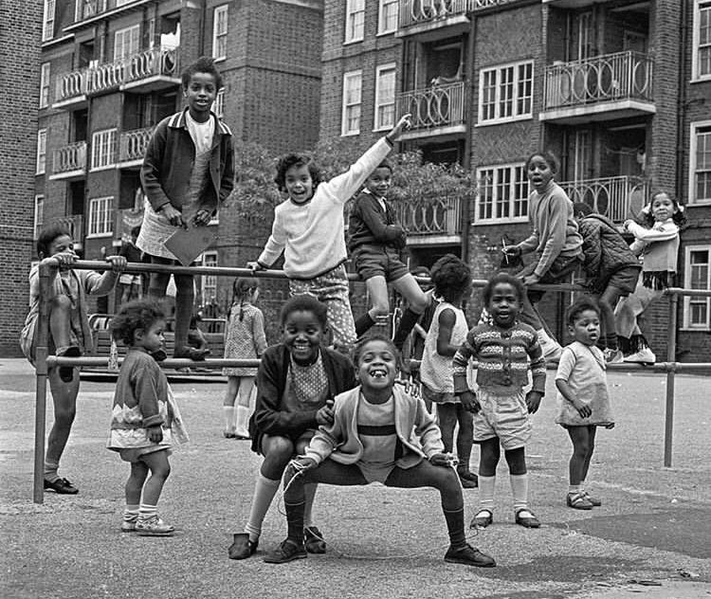
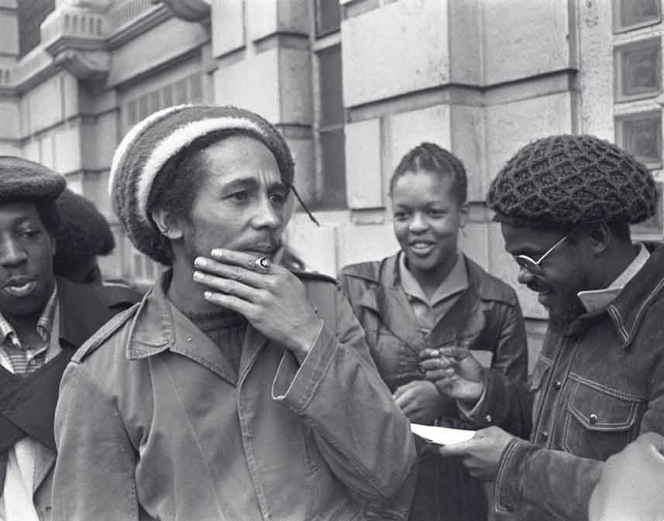
To understand the Uprising we first need to understand Brixton’s history before the Uprisings. To do so we’re going to listen to a short clip from a podcast series called Brixton: Flames on the Frontline. The podcast was created by Big Narstie for the BBC in 2022.
Task: As we listen to the podcast add your ideas to the spider diagram, to explain what life was like in Brixton in the years before the Uprisings.
Brixton: Flames on the Frontline - Episode 1: The Fuse is Lit - BBC Sounds
Discussion Point:
The podcast mentioned the Windrush – what do you know about this?
Lesson Objectives
Outline the causes and events of the 1981 Brixton Uprising.

Slide 7
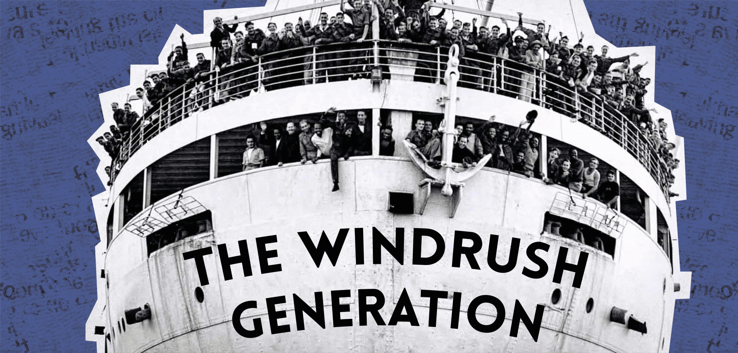
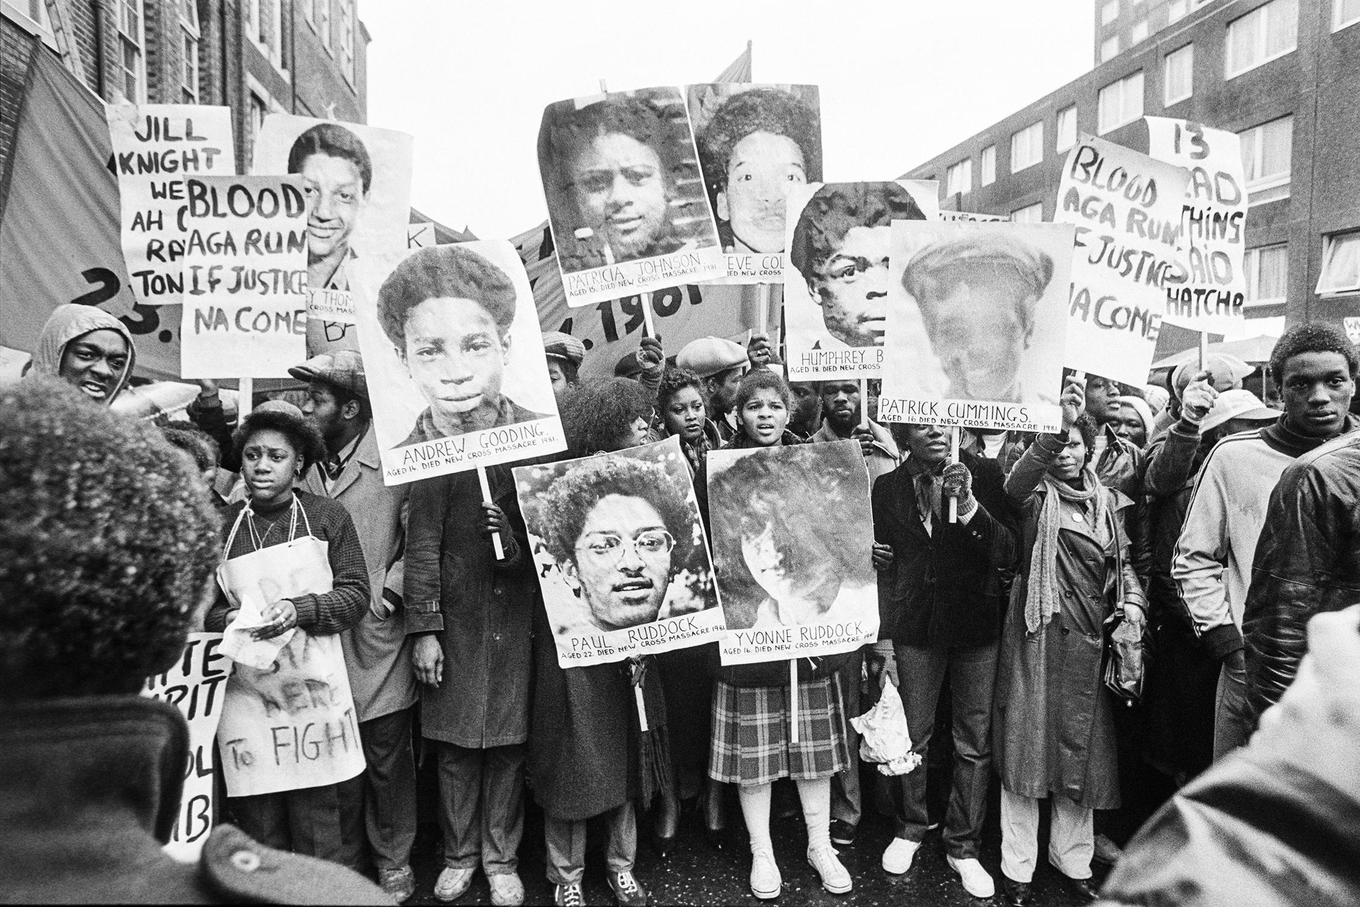
The Windrush was one of the first ships taking migrants from the Caribbean to Britain. Between 1948 and 1970, nearly half a million people moved from the Caribbean to Britain, as the British government promised jobs in helping to rebuild Britain after the war. Many families settled in Brixton.
Discussion Point:
Why was there so much tension in Brixton between the local community and the police?
This tension eventually exploded in the events of the 1981 Uprising. But what caused the Uprising itself? And what happened during it?
Task: Answer the questions as we watch the short documentary video on the causes and events of the 1981 Uprising. This video has been produced specifically for classroom use, but it is largely made up of clips from Steve McQueen’s Uprising documentary series.
https://www.bbc.co.uk/teach/class-clips-video/ks3-gcse-history-uprising/zqq94xs
Lesson Objectives
Outline the causes and events of the 1981 Brixton Uprising.

Slide 8
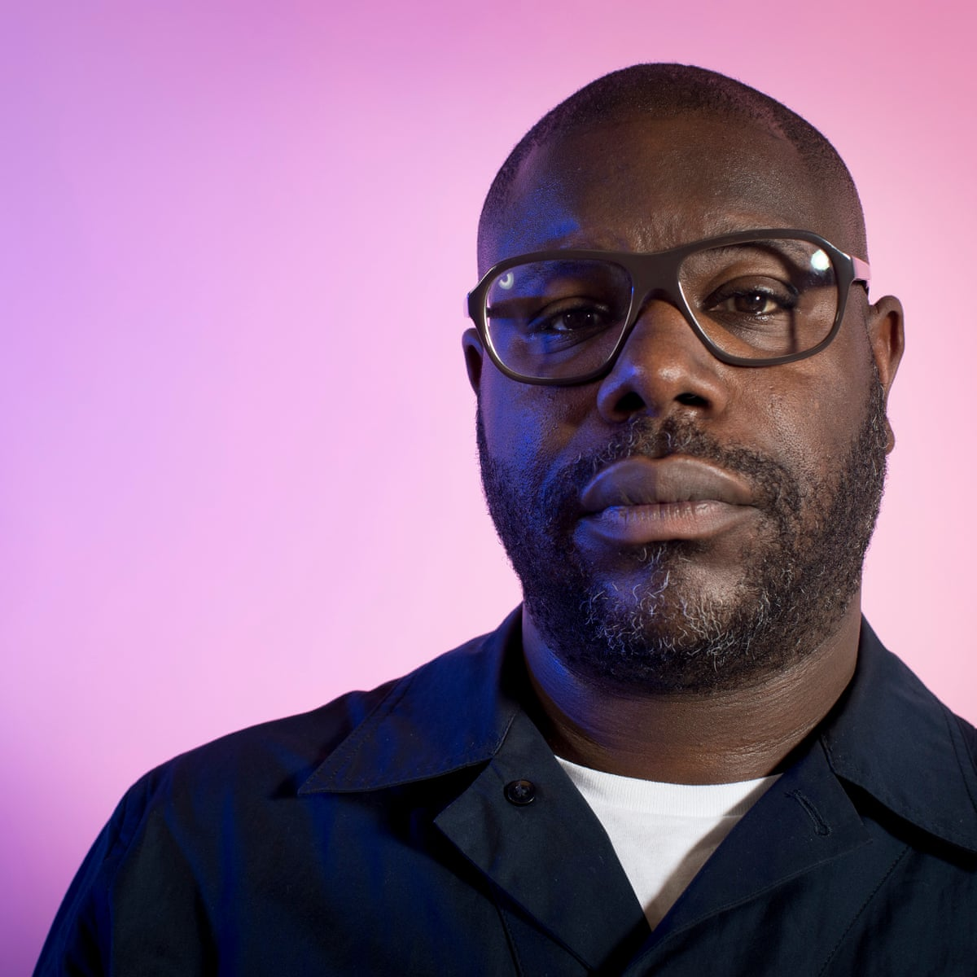
Discussion Point:
What Black British history do people know the most about?
Why do you think the story of the Brixton Uprising may be less well known?
Have you got any early suggestions why Steve McQueen decided it was an important story to tell in 2021?
Lesson Objectives
Outline the causes and events of the 1981 Brixton Uprising.

Slide 9
Starter: Steve McQueen’s View of the 1981 Brixton Uprisings
‘These events were just pivotal moments and were moments that somehow got brushed under the carpet for the broader, wider public and they needed to come out into the light.
These are historical moments, not just for Black British people, but for British people in general because these events have reverberated throughout the nation. We need to shine a light on it [and], we needed to give it the platform it deserved.” (Daily Express interview, 21st July 2021)
Starter: Steve McQueen’s View of the 1981 Brixton Uprisings
‘These events were just pivotal moments and were moments that somehow got brushed under the carpet for the broader, wider public and they needed to come out into the light.
These are historical moments, not just for Black British people, but for British people in general because these events have reverberated throughout the nation. We need to shine a light on it [and], we needed to give it the platform it deserved.” (Daily Express interview, 21st July 2021)
Starter: Steve McQueen’s View of the 1981 Brixton Uprisings
‘These events were just pivotal moments and were moments that somehow got brushed under the carpet for the broader, wider public and they needed to come out into the light.
These are historical moments, not just for Black British people, but for British people in general because these events have reverberated throughout the nation. We need to shine a light on it [and], we needed to give it the platform it deserved.” (Daily Express interview, 21st July 2021)
Starter: Steve McQueen’s View of the 1981 Brixton Uprisings
‘These events were just pivotal moments and were moments that somehow got brushed under the carpet for the broader, wider public and they needed to come out into the light.
These are historical moments, not just for Black British people, but for British people in general because these events have reverberated throughout the nation. We need to shine a light on it [and], we needed to give it the platform it deserved.” (Daily Express interview, 21st July 2021)
Task: Stick the sheet in, and then underneath translate its meaning into really simple language that a primary school student could understand.
Task: Stick the sheet in, and then underneath translate its meaning into really simple language that a primary school student could understand.
Task: Stick the sheet in, and then underneath translate its meaning into really simple language that a primary school student could understand.
Task: Stick the sheet in, and then underneath translate its meaning into really simple language that a primary school student could understand.

Slide 10
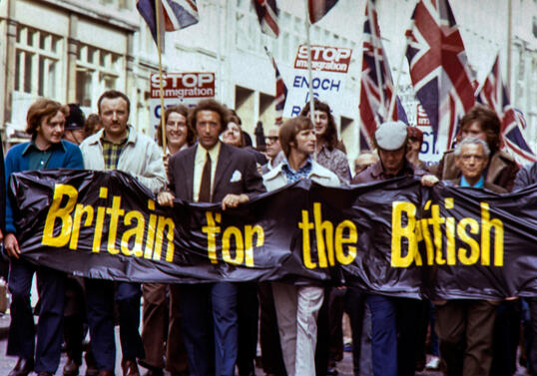
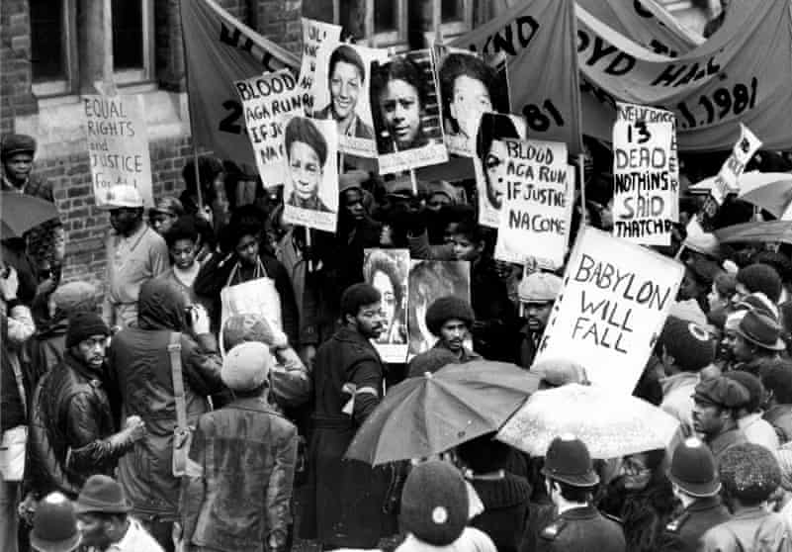
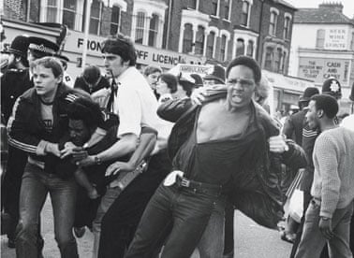
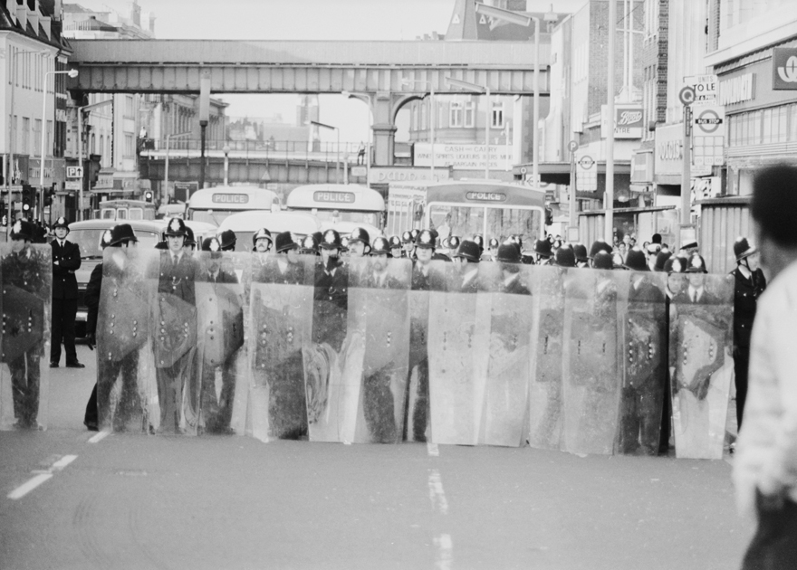
The Brixton Uprising, 1981: Causes and Events
Racism Towards the Black Community in London
National Front Actions:
New Cross Fire, 18th January 1981
Black People’s Day of Action, 2nd March 1981
Policing in Brixton - Operation Swamp, April 1981
Brixton Uprising, 10th April 1981
Other cities:
Life in Brixton in the 1970s
Community
Music
Treatment by the Police
Racism
Everyday Life

