Slide 1
Teacher Instructions
Print: Slide 9 (1 for every 4 students), Slide 10 (1 for every student)
Video Clip 1:
https://www.youtube.com/watch?v=lrIAexK_FII
2.36- end (though you could show them the first two minutes if they want a refresher on Brixton)
Video Clip 2:
You’ll need to sign in to BBC Iplayer:
BBC iPlayer - Uprising - Series 1: 3. The Front Line
Only play 44.10 to 59.08 (the point where she says she is feeling really emotional)

Slide 2
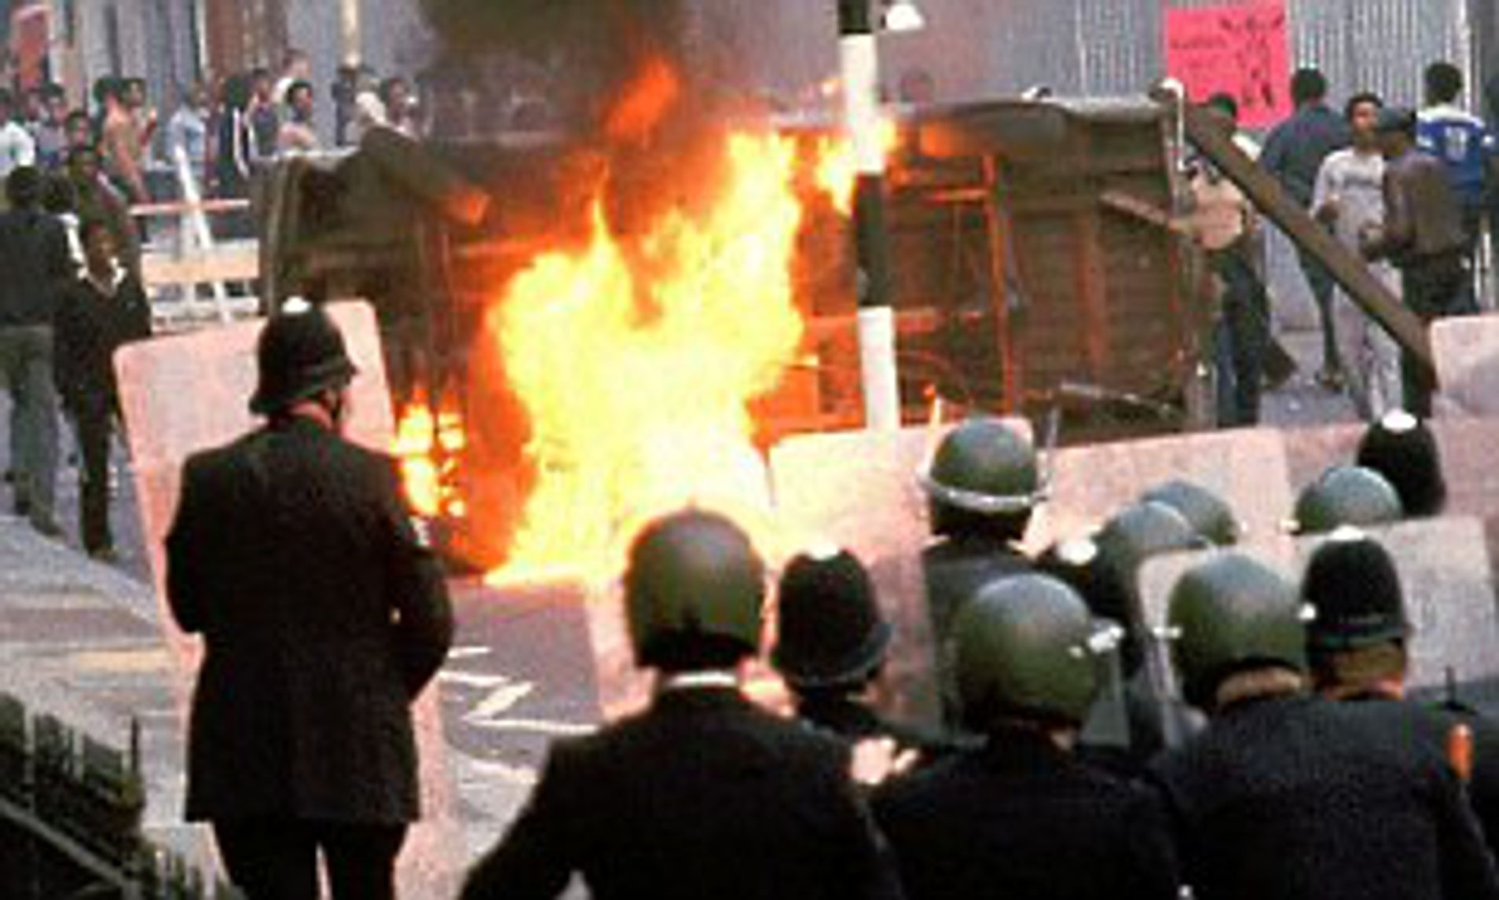
Module 8: Why did Steve McQueen decide to shine a light on the Brixton Uprisings in 2021?
Tuesday, 09 January 2024
Write this module title down and double-underline it. Then stick in the starter sheet and complete the task.

Slide 3
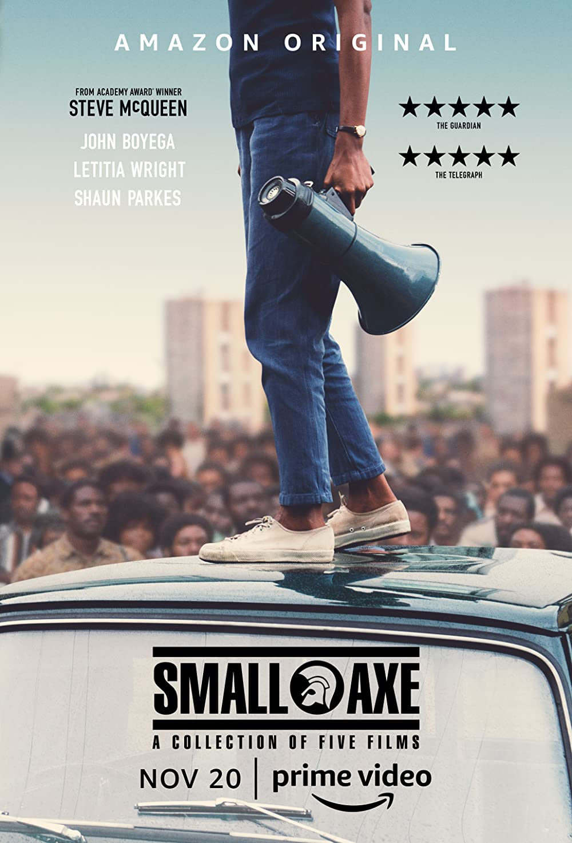
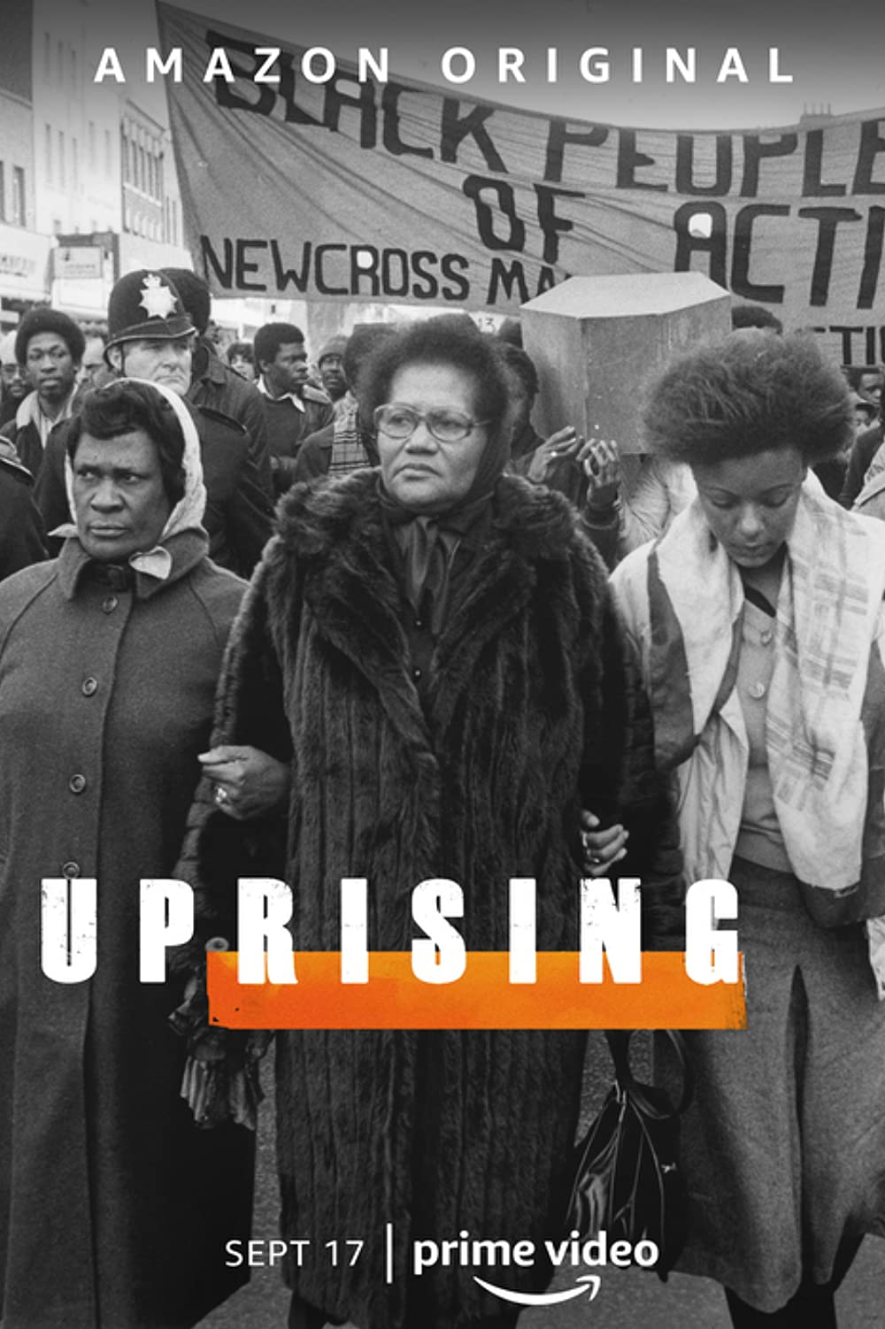
Why did Steve McQueen decide to shine a light on the Brixton Uprisings in 2021?
In 2021 the Oscar winning British director Steve McQueen released a series of films telling the story of five key moments in Black British history. He also released an accompanying documentary series called Uprising, which told the story of the 1981 Brixton Uprising. This series won the prestigious title of best documentary series at the 2022 BAFTA awards.
‘These events were just pivotal moments and were moments that somehow got brushed under the carpet for the broader, wider public and they needed to come out into the light.
These are historical moments, not just for Black British people, but for British people in general because these events have reverberated throughout the nation. We need to shine a light on it [and], we needed to give it the platform it deserved.” (Steve McQueen- Daily Express interview, 21st July 2021)

Slide 4
2. What happened after the Uprisings?
Module 8: Why did Steve McQueen decide to shine a light on the Brixton Uprisings in 2021?
Tuesday, 09 January 2024
Lesson Objectives
Outline the national reaction to the Uprisings.
Starter
How many young people died in the New Cross fire in January 1981?
What was the name of the protest march in March 1981 to demonstrate anger against the police investigation into the fire?
What was Operation Swamp in April 1981?
What sparked the Brixton Uprising on the 10th April 1981?
Extension: How does racism within the police relate to all these events?

Slide 5
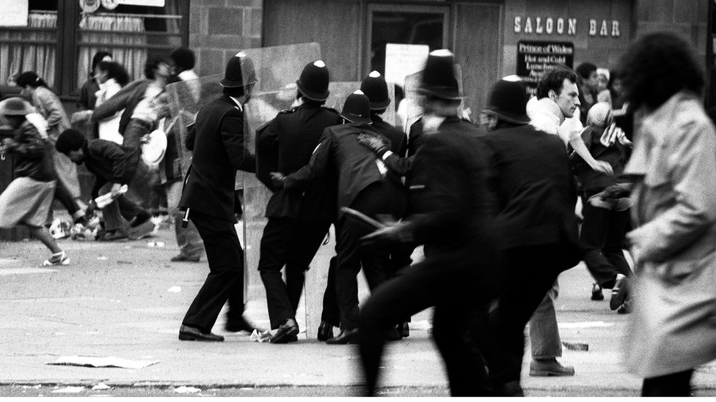
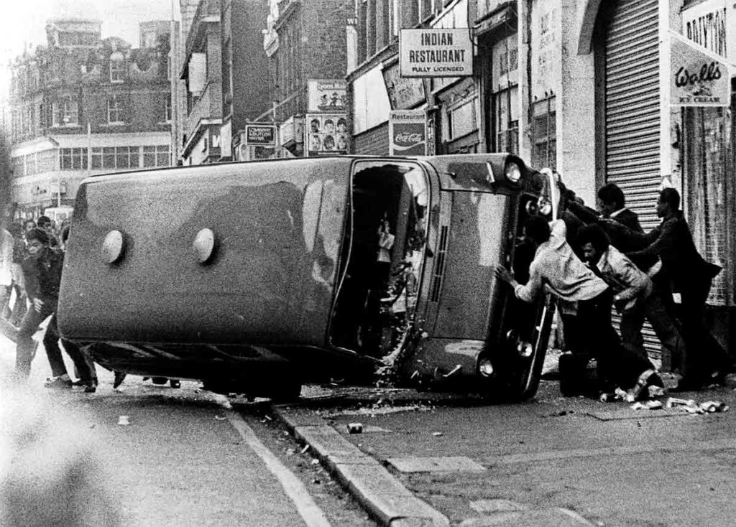
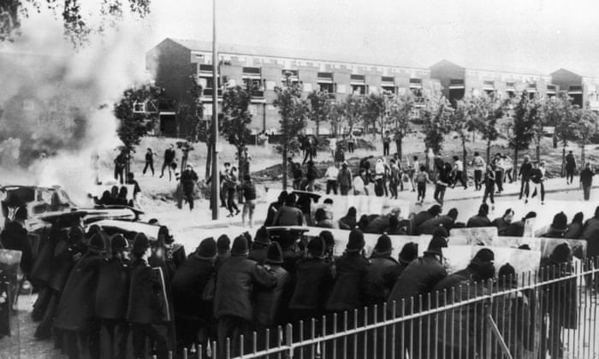
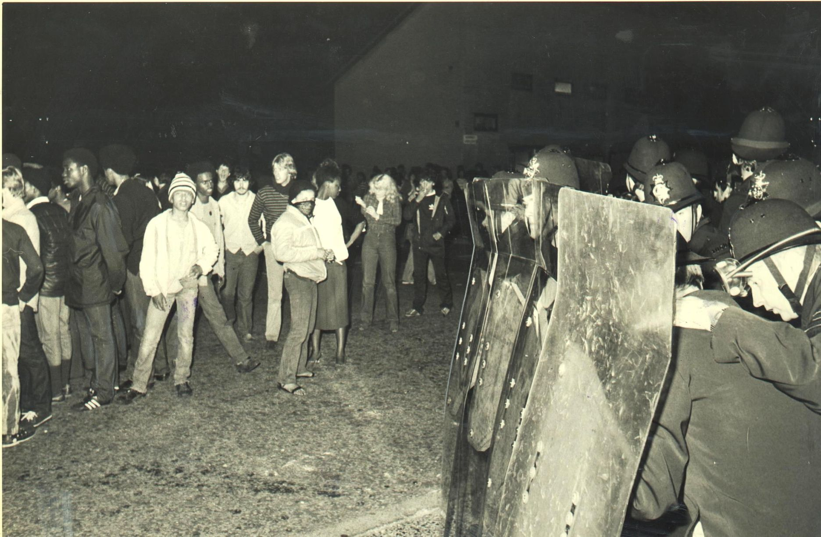
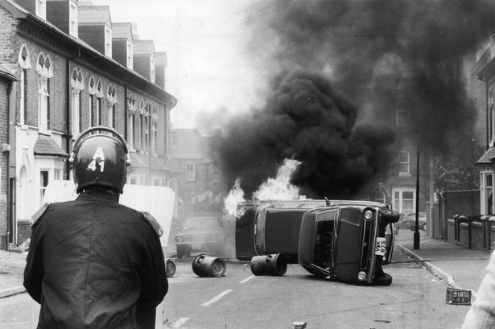
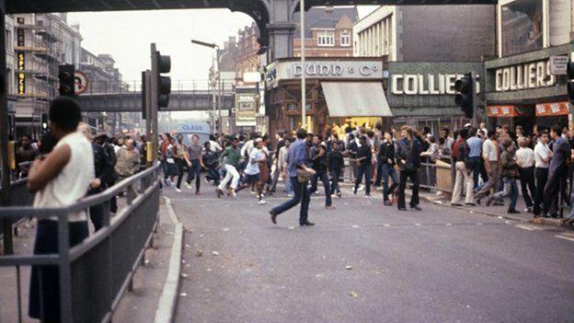
Last lesson we looked at the causes and events of the Brixton Uprising, which became the main focus of Steve McQueen’s documentary.
Discussion Point:
Look at the photos below. What words do you associate with them? For example, anger.
Brixton, London, 1981
Brixton, London, 1981
Toxteth, Liverpool, 1981
Moss Side, Manchester, 1981
What is fascinating is that not all of these photos depict the 1981 Brixton Uprising…
Discussion Point: What does this tell you about the reaction to the Uprising?
Handsworth, Birmingham, 1981
Brixton, London, 1985
Lesson Objectives
Outline the national reaction to the Uprisings.

Slide 6
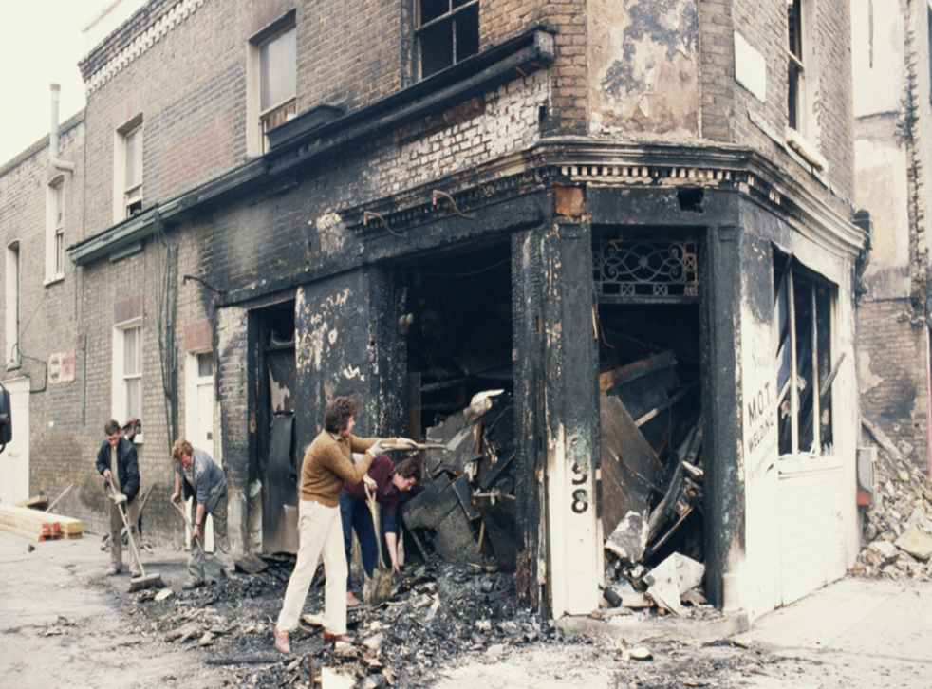
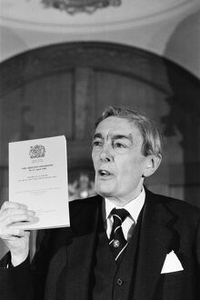
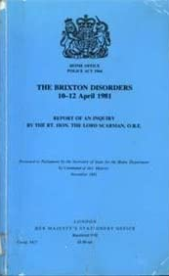
The uprisings spread to cities across the country in the 1981. The anger and frustration seen in Brixton was clearly a wider national issue.
Task 1: As we watch the short video clip, add information to the map to for each location.
Discussion Point:
What do all the Uprisings in 1981 have in common?
The government clearly couldn't ignore what was happening. But what was the reaction to these events which shook the nation?
Task 2: Answer the questions as we watch the clip on the reaction to the 1981 Uprisings. This video is from the final episode of Steve McQueen’s Uprising documentary series.
Lesson Objectives
Outline the national reaction to the Uprisings.

Slide 7
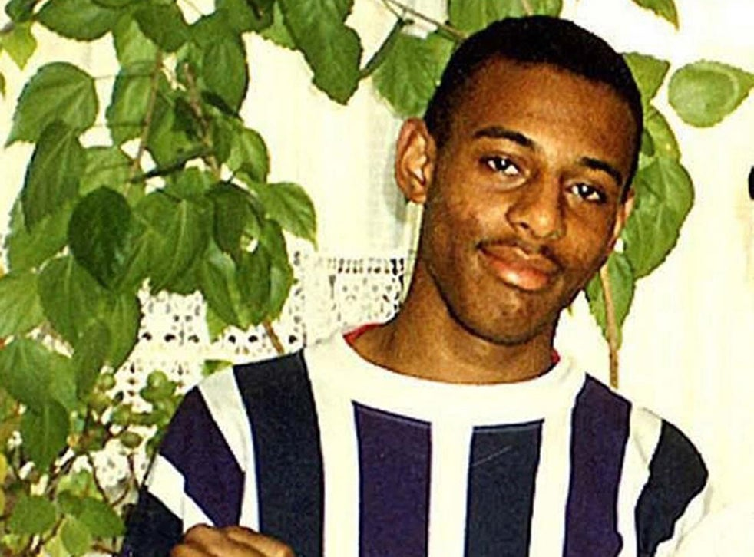
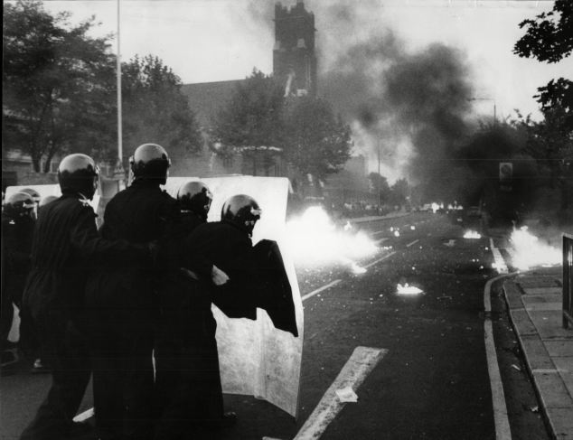
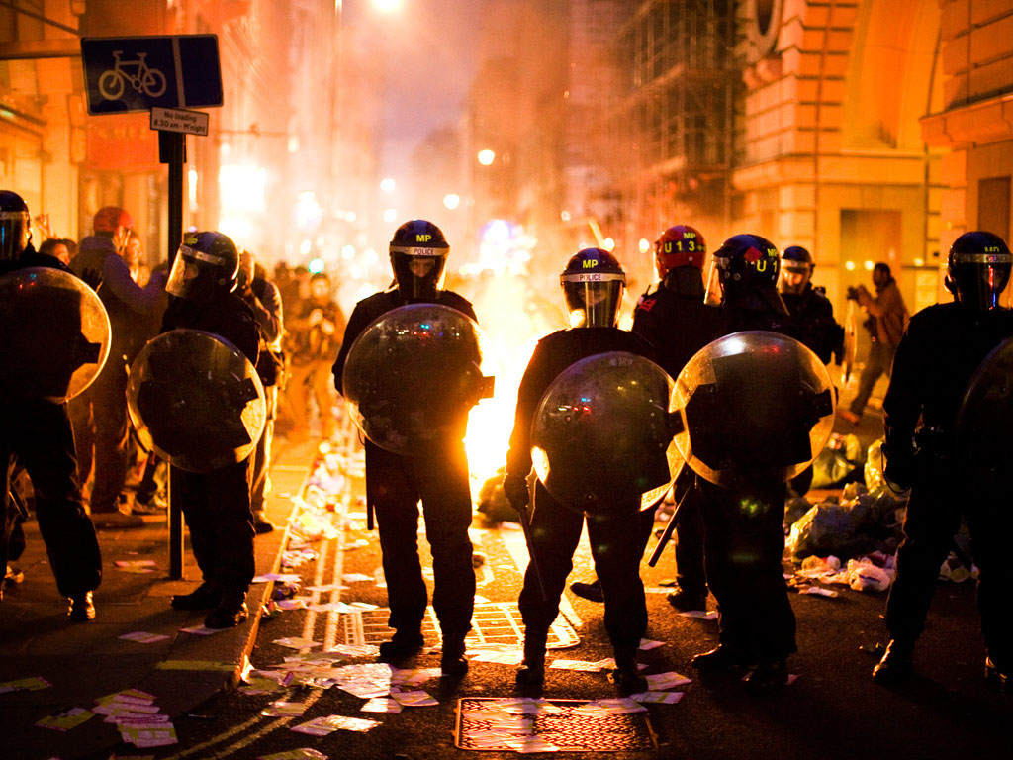
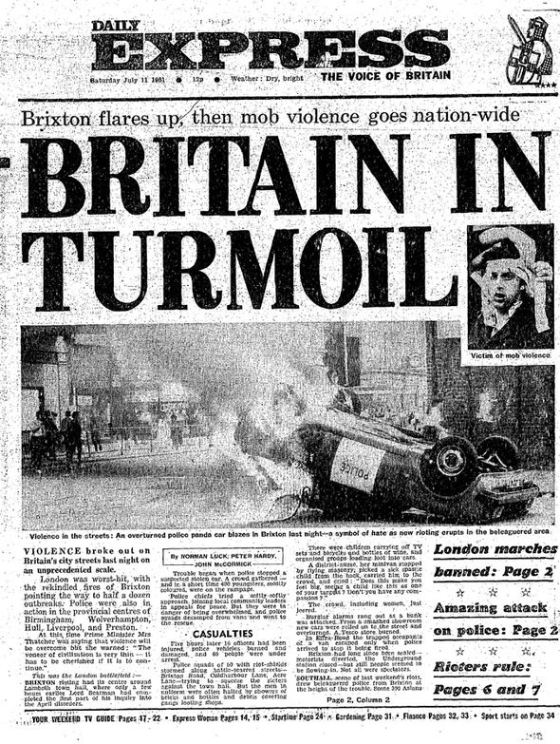
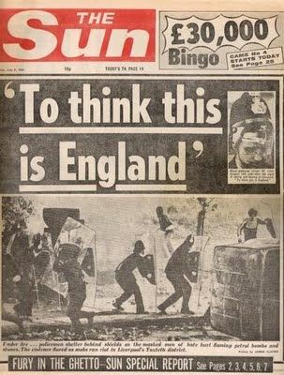
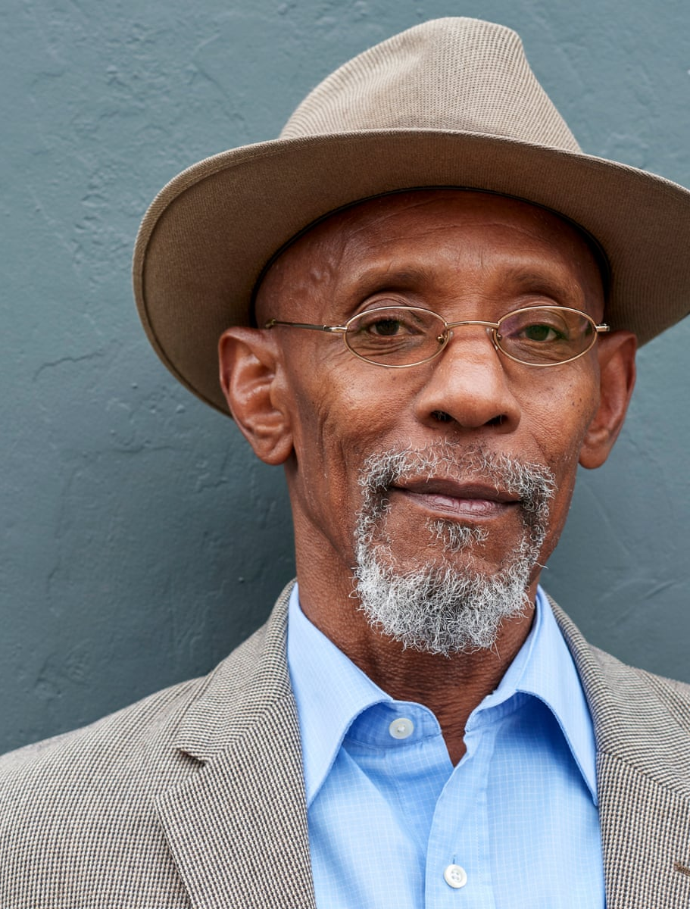
Discussion Point:
How did the Black community’s reaction to the 1981 uprising differ from the rest of the country’s?
From the start there was a clear divide as to how many saw the events of 1981 as a riot, whilst the Black community saw it as an uprising. This would influence the impact of the uprisings in the years after, and their cultural legacy.
Task 3: Read the sheet, and add brief summary notes to the impact diagram as you do on the impact of the 1981 Uprising on Britain.
Stephen Lawrence
Brixton, 1985
London, 2011
Press Coverage, 1981
Linton Kwesi Johnson
Lesson Objectives
Outline the national reaction to the Uprisings.

Slide 8
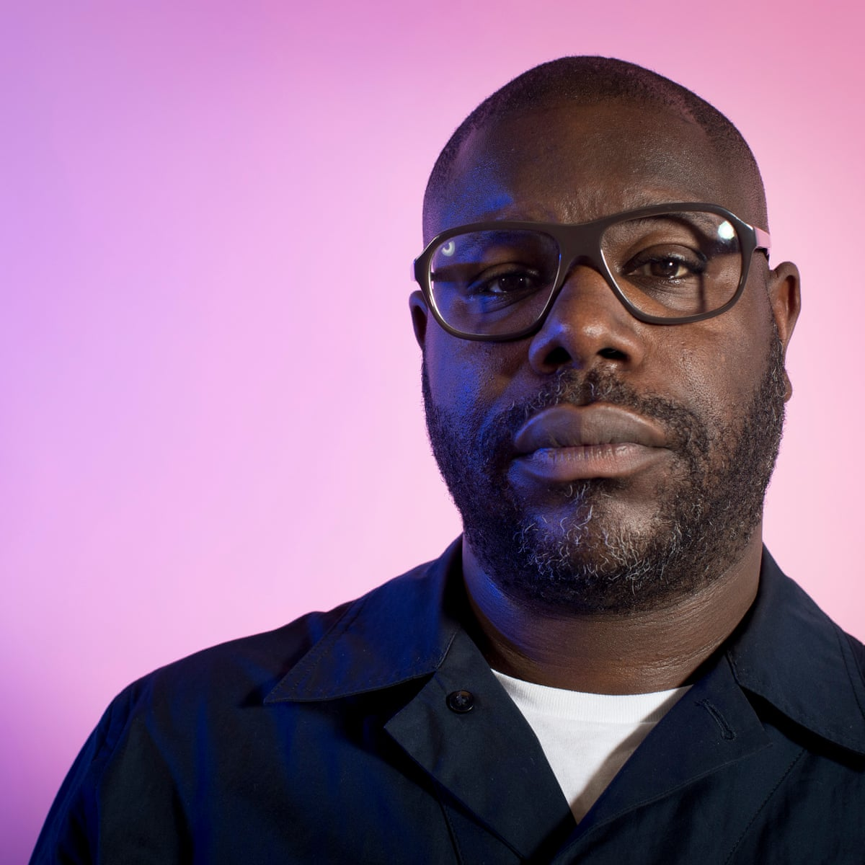
Silences over historical topics are fascinating to analyse. Outside of the Black community there had been little interest or attempts to remember the Brixton Uprisings until the BBC and Amazon supported Steve McQueen in making his Small Axe series and his Uprising documentary in 2021. This was exactly forty years since the initial uprising.
Discussion Point:
Do you think the mainstream silence over the uprisings was most likely due to:
A lack of interest in the Uprisings as they only affected the Black community?
A lack of understanding over why these events were important to remember?
Something else?
Lesson Objectives
Outline the causes and events of the 1981 Brixton Uprising.

Slide 9
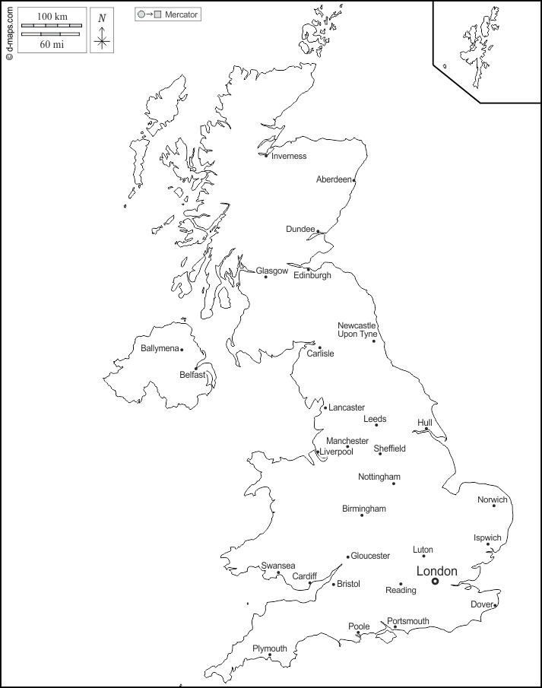
1981: Uprisings Outside of Brixton
Moss Side, Manchester
Cause:
Facts:
Impact Diagram
Stephen Lawrence Case, 1993
Toxteth, Liverpool
Cause:
Facts:
Limited Impact
Handsworth, Birmingham
Cause:
Facts:
Protests in:
Scarman Report, 1981
Policing
Uprising Documentary: The Reaction to the Uprisings
1. What was reaction of the Prime Minister Margaret Thatcher and the government to the Uprising?
2. A government investigation into the riots was put in place. In November 1981 a report was published called the Scarman report which outlined the investigation findings. What did it say?
3. Did the Scarman report’s findings lead to change in the police?
4. How did the Black community feel about the Uprisings?
Similar Protests
1985 Brixton Uprising and Broadwater Farm Uprising
1981 Uprisings
2011 Riots
Cultural Legacy
Press Coverage
Black Community Reaction
Popular Culture

Slide 10
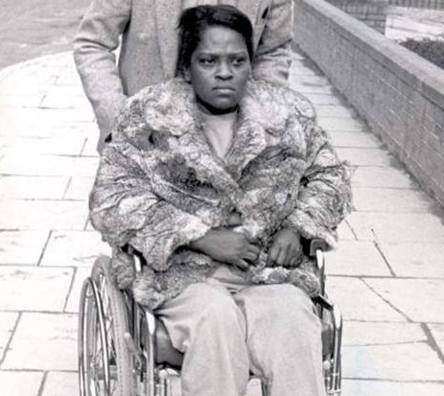
Consequences for Policing
The Scarman report was commissioned by the UK government following the 1981 Uprisings. According to the Scarman report, the riots were a spontaneous outburst of built-up resentment sparked by a series of poor policing decisions and exacerbated by Operation Swamp. Lord Scarman stated that ‘complex political, social and economic factors’ created a ‘disposition towards violent protest’.
The Scarman report highlighted problems of racial disadvantage and inner city decline, warning that ‘urgent action’ was needed to prevent racial disadvantage becoming an ‘endemic, ineradicable disease threatening the very survival of our society’. Scarman recommended changes in training and law enforcement, and an increase of the number of ethnic minorities in the police. In 1984 changes were made to policing in response to the report, such as writing up a record of every stop and search made which included noting the ethnicity of the suspect. This was to try and deter police officers from targeting Black suspects more than white suspects.
In spite of these recommendations, the darkest hour in the relationship between the police and the Black community was still to come. On the evening of April 22 1993, 18-year-old aspiring architect Stephen Lawrence was attacked by white, racist youths as he waited at a bus stop in Eltham, south-east London. The racism was – or should have been – obvious from the start. However, the police initially didn’t investigate it as a racist attack.
Within days of the stabbing, dozens of people had given the names of the suspected killers to police. Two of the attackers were also caught on a police surveillance camera talking about killing Black people. However, in July 1993 charges against five arrested suspects were dropped. Many people in the Black community blamed this on police racism. An investigation was later carried out into what went wrong in the Stephen Lawrence case, and the resulting Macpherson Report of 1999 suggested a key factor was ‘institutional racism’ in London's Metropolitan Police.
Similar Protests
The tensions between the Black community and police that had led to the 1981 Brixton Uprising did not disappear, and there was now a new confidence in responding to the police through violence. In September 1985 another Uprising took place. This time it was in response to the accidental shooting of Cherry Groce. She was left paralysed from the waist down when she was shot by police during a raid on her home. They were looking for her son Michael in connection with a robbery. The local community took to the streets, in scenes reminiscent of those four years previously. 50 people were injured and there were more than 200 arrests. A photographer, Davod Hodge, who was covering the events for a national newspaper died from injuries sustained during the events.
Just a week later a similar uprising took place on the Broadwater Farm housing estate in Tottenham on the 5th October 1985. An estate resident Cynthia Jarrett died of heart failure after four policemen burst into her home during a raid. Again the local community took to the streets, and 500 police were brought in to the area to stop the uprising. By midnight 58 policemen and 24 other people had been taken to hospital, and one policeman was killed.
Many of the themes of these uprisings can also be seen in the events that shook the country in 2011. Violence erupted on the streets of the capital and other major cities across England after the shooting of Mark Duggan, a 29 year old Black man, by a police officer in Tottenham. There was widespread damage to buildings and looting. 185 police officers were injured, and over 2000 people arrested. The 2013 inquest into Duggan’s death ruled his shooting as lawful, due to the fact he was in possession of a firearm at the time. However, the events surrounding his shooting remain a source of contention.
Cultural Impact
From the start the reaction to the uprisings in mainstream British culture was largely critical. The major newspapers at the time largely took the side of the police and the government, and framed the 1981 Brixton Uprising as a riot. The Daily Express described the events as ‘mob violence’, whilst The Sun ran with the sub-heading ‘Fury in the ghetto’. There was major focus on injured policemen, but very little coverage of the causes of what had taken place. The newspaper coverage of the Brixton Uprising in 1985 followed a similar pattern, with few serious attempts to analyse the causes. The newspaper reporting in the 1980s had created the image of those involved in the uprisings as rioters.
However, the Black community never accepted this framing of the events as rioting. This can be seen in the lyrics of renowned Brixton dub poet Linton Kwesi Johnson’s depiction of the events as a ‘great insoreckshan’ (great insurrection, meaning uprising or rebellion) in a poem first performed in 1983. Another Black artist who drew attention to the 1981 Uprising was the musician Eddy Grant, whose 1983 hit Electric Avenue about life in Brixton opened with the words ‘in the street there is violence’ and focused on the poverty in the area. The uprisings had also drawn attention to Brixton from the Black community across the world. It was no coincidence that Nelson Mandela chose to visit Brixton in 1996, where a crowd of over 12,000 greeted him.
However, outside of the Black community there were very few attempts to keep the memory of the uprisings alive. Alex Wheatle’s 2001 novel East of Acre Lane did have mainstream success, but there have been very few novels by British authors depicting the events of 1981. In 2012 the BBC broadcast Rex Obano’s radio drama Lover’s Rock, which focused on the events leading up to the Brixton uprisings. However, beyond this there were no major television drama, theatre productions or musical or art projects centred on the uprisings. It was only in 2021 that changed with Steve McQueen’s Small Axe series, and accompanying documentary Uprising. This brought much wider attention to the story of the uprisings, both in Britain and internationally.
Left: Brixton in 1985, and Cherry Groce
Right: London in 2011

Slide 11
Linton Kwesi Johnson, Di Great Insohreckshan, YouTube
Eddy Grant, Electric Avenue, YouTube

Slide 12
