Slide 1
Teacher Instructions
Print: Slide 9 (1 for every 4 students), Slide 10 (1 for every student) – separate and 1 sided
Video Clip 1:
The Brixton Uprisings: An Interview with Leila Hassan Howe – YouTube (7.17)
Video Clip 2:
The Brixton Uprisings: An Interview with George Rhoden – YouTube (7.30)
Video Clip 3:
The Brixton Uprisings: An Interview with Ros Griffiths – YouTube (7.53)
Unedited just to warn you, so a bit longer. Currently waiting on edited version.
Homework: Works best if it is for next lesson as potential starter task, but if the turnaround is too quick set it for when you teach Lesson 5 instead. I will build flexibility into this.

Slide 2
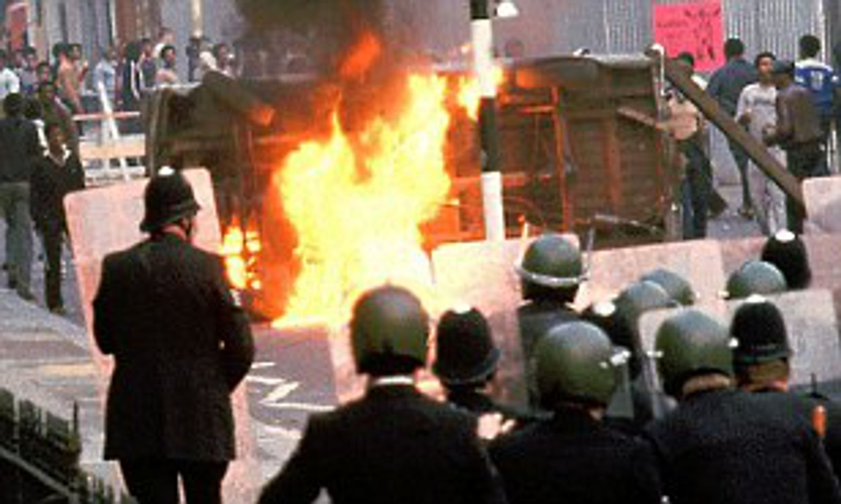
Module 8: Why did Steve McQueen decide to shine a light on the Brixton Uprisings in 2021?
Tuesday, 09 January 2024
Write this module title down and double-underline it. Then stick in the starter sheet and complete the task.

Slide 3
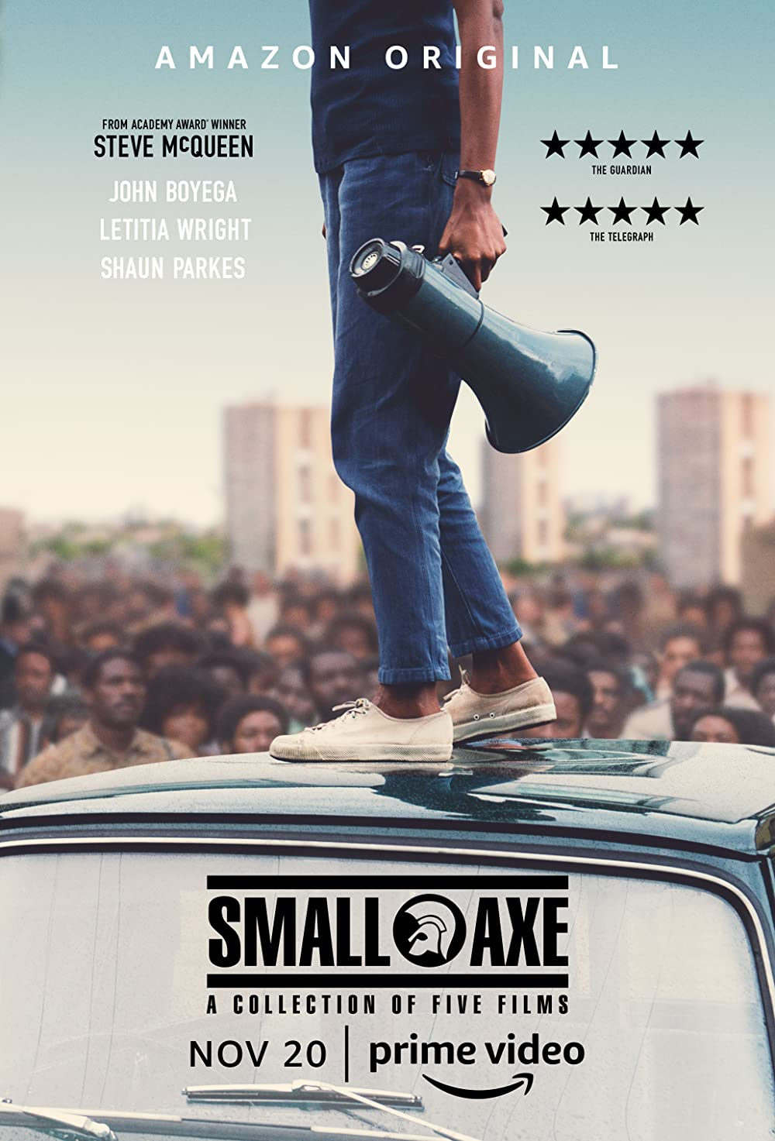
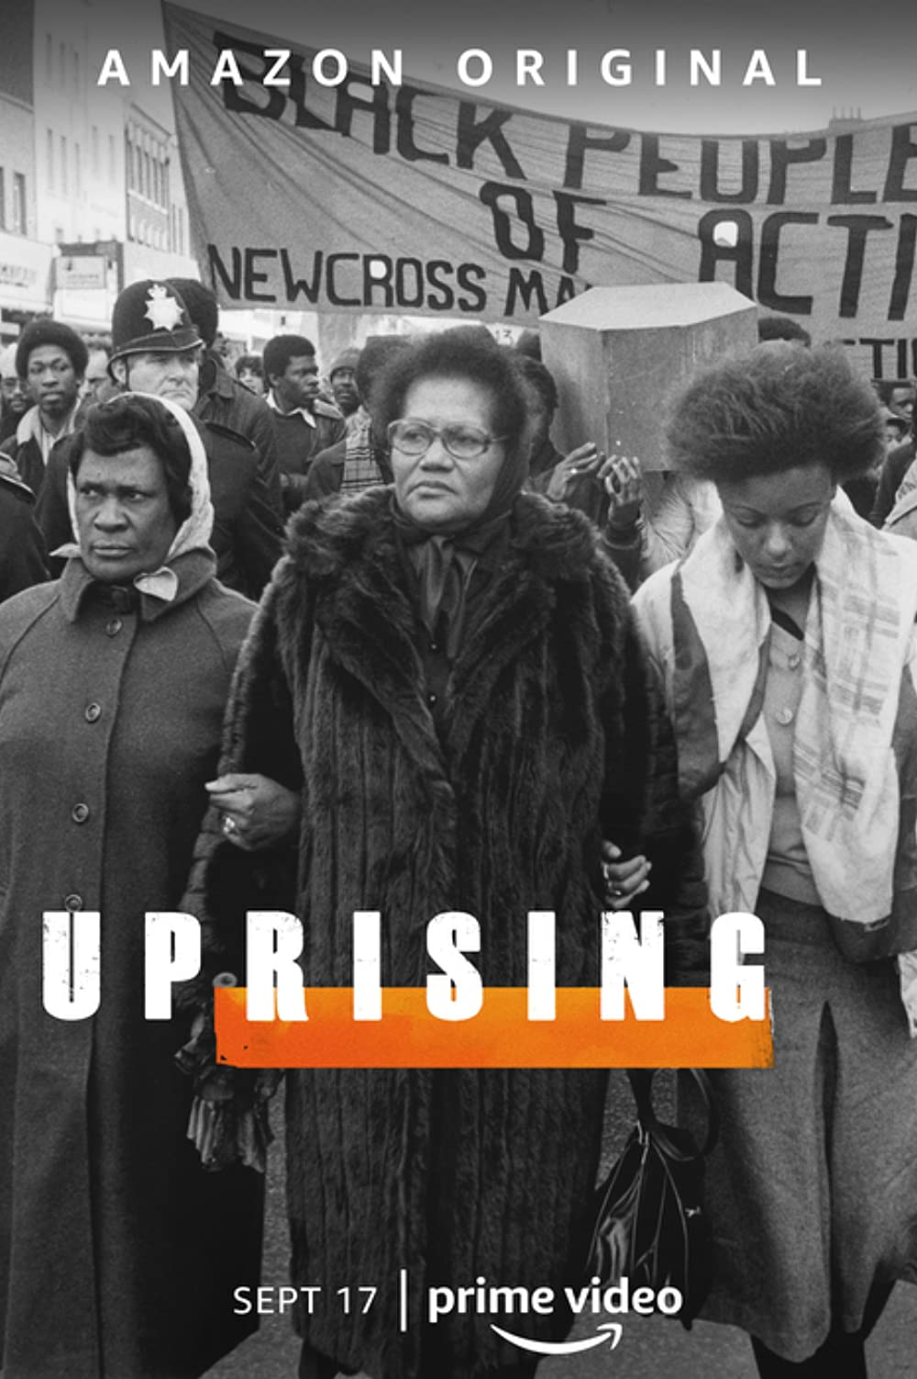
Why did Steve McQueen decide to shine a light on the Brixton Uprisings in 2021?
In 2021 the Oscar winning British director Steve McQueen released a series of films telling the story of five key moments in Black British history. He also released an accompanying documentary series called Uprising, which told the story of the 1981 Brixton Uprising. This series won the prestigious title of best documentary series at the 2022 BAFTA awards.
‘These events were just pivotal moments and were moments that somehow got brushed under the carpet for the broader, wider public and they needed to come out into the light.
These are historical moments, not just for Black British people, but for British people in general because these events have reverberated throughout the nation. We need to shine a light on it [and], we needed to give it the platform it deserved.” (Steve McQueen- Daily Express interview, 21st July 2021)

Slide 4
3. What can oral history tell us about the importance of the Brixton Uprisings?
Module 8: Why did Steve McQueen decide to shine a light on the Brixton Uprisings in 2021?
Tuesday, 09 January 2024
Lesson Objectives
Analyse interviews with people connected to the Uprisings.
Starter
Name three causes of the Brixton Uprising on the 10th April 1981?
In what year was there another uprising in Brixton after the shooting of Cherry Groce?
What was the name of the Black teenager who was murdered in south-east London in 1993, and whose case exposed that racial prejudice was still a problem in the police?
Which famous figure visited Brixton in 1996?
Extension: What is oral history?

Slide 5
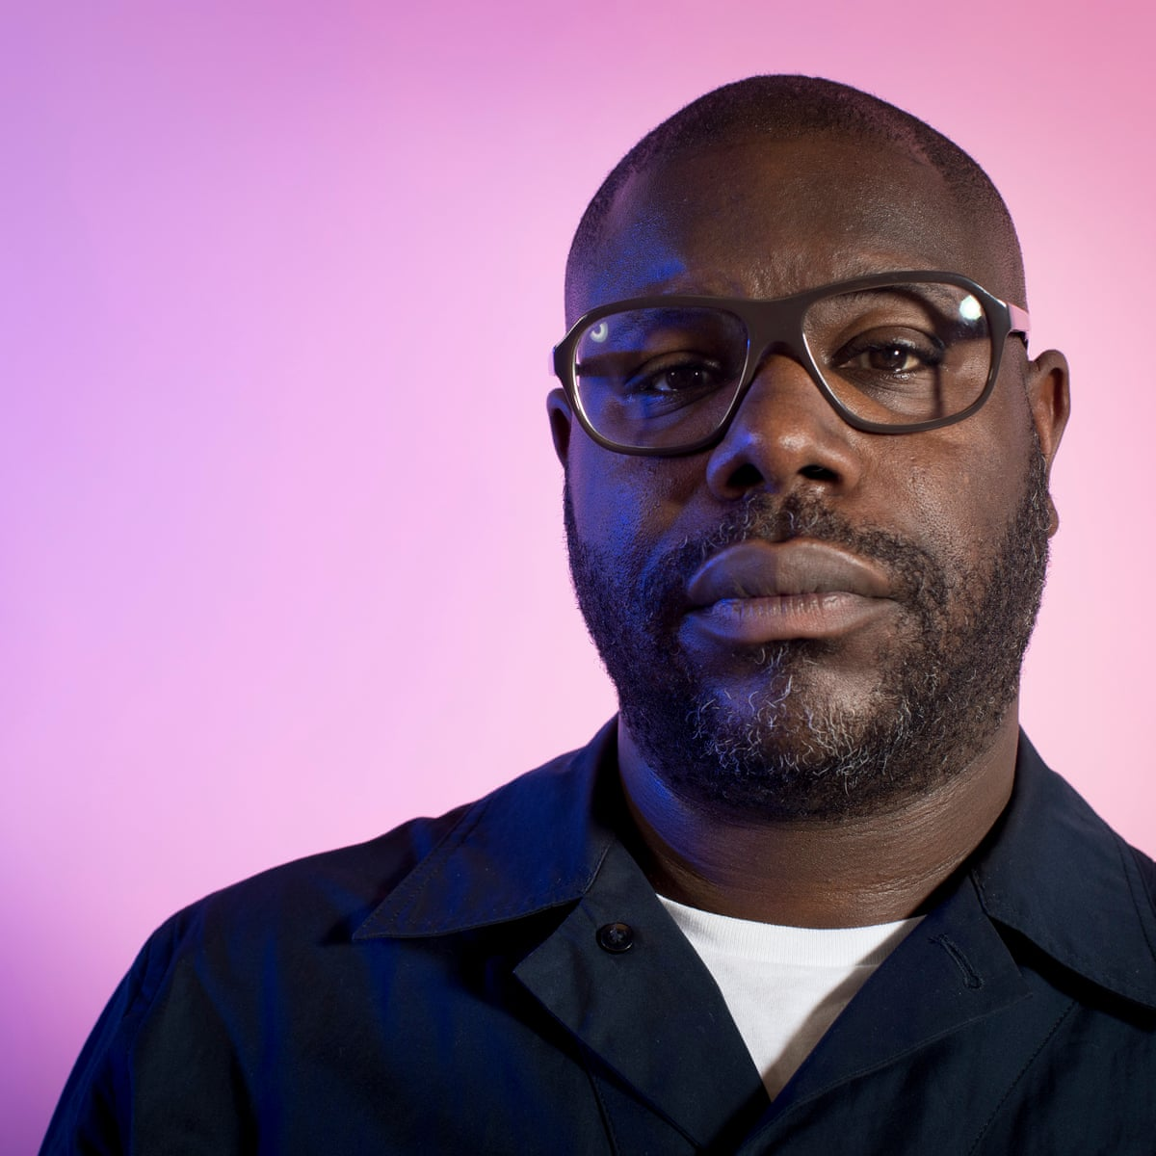
In the first lesson of this enquiry we saw that Steve McQueen had a very clear view of why he was making his documentary:
‘These are historical moments, not just for Black British people, but for British people in general because these events have reverberated throughout the nation. We need to shine a light on it [and], we needed to give it the platform it deserved.”
(Steve McQueen- Daily Express interview, 21st July 2021)
Discussion Point:
Based on what we’ve seen studied so far, what is your view as to why these are important events in modern British history?
These are just our views though. To really understand why these are such important events we need to ask people who are closely connected to them…
Lesson Objectives
Analyse interviews with people connected to the Uprisings.

Slide 6
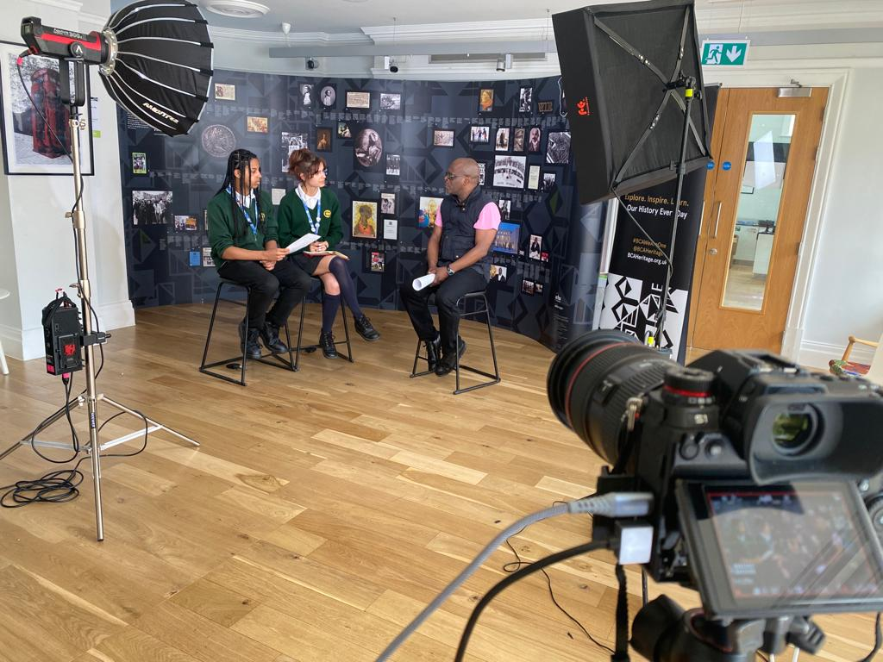
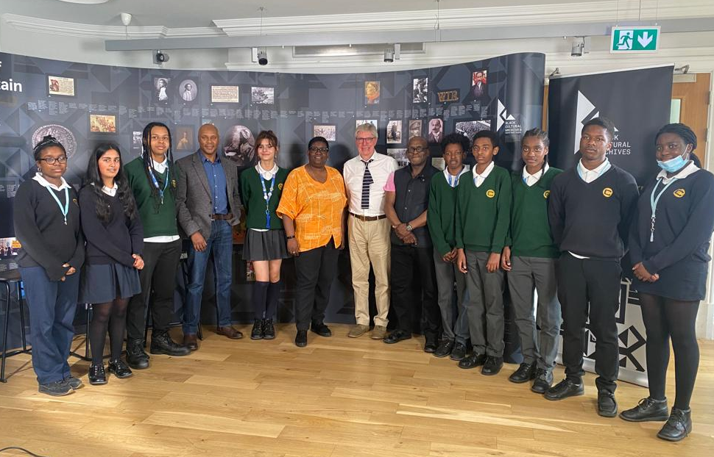
In May 2022 students from Charter North Dulwich and Charter East Dulwich were given the opportunity to interview individuals with unique connections to the Brixton Uprisings. The project was carried out in collaboration with the Black Cultural Archives in Brixton.
The students involved were collecting oral history. They were given training in conducting interviews, and were then asked to create questions based on their research of the interviewees.
Oral history: The collection and study of historical information using recordings of interviews with people having personal knowledge of past events
Discussion Point:
What are the strengths of carrying out historical research this way?
What are the potential problems?
Lesson Objectives
Analyse interviews with people connected to the Uprisings.

Slide 7
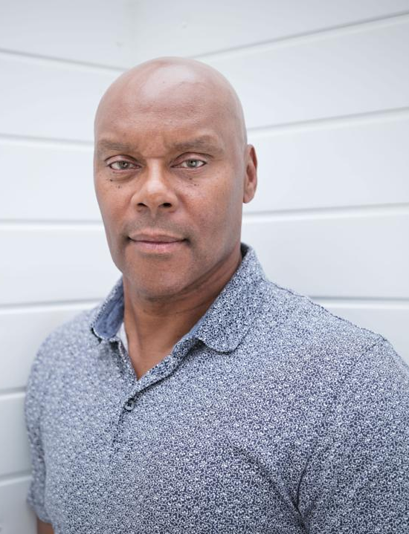
Main Task: We are going to watch three interviews with individuals connected to the 1981 Brixton Uprising.
As you watch each interview, answer the questions on your sheet. Be prepared to discuss each interview afterwards with your partner.
Interview 1:
Leila Hassan Howe
Racial justice campaigner
Interview 2:
George Rhoden
Former police officer
Interview 3:
Ros Griffiths
Local community activist
Discuss:
Discuss:
Discuss:
What did you think was the most surprising aspect of Leila’s interview?
Why does George provide provides historians with such a useful insight into the Uprising?
Do you think Ros is correct to describe the Uprising as ‘the first Black Lives Matter’?
Lesson Objectives
Analyse interviews with people connected to the Uprisings.

Slide 8
Final Task: Work with your partner to create a spider diagram of the different reasons the interviewees said the Brixton Uprising was important. Were there any themes which came up again and again? Your spider diagram should take up about a third of a page.
Oral History Project Conclusions:
The Importance of the Brixton Uprisings
Homework: Today we have looked at the importance of the 1981 Uprising, but what about the 1985 Uprising? For homework watch two further interviews, and answer the questions on each one. We will add our conclusions to the spider diagram from this session.
Lesson Objectives
Outline the causes and events of the 1981 Brixton Uprising.

Slide 9
1981 Brixton Uprising: Leila Hassan Howe
Leila helped organise the Black People's Day of Action to protest against the New Cross Fire prior to the Uprising. She also witnessed the 1981 Uprising herself. Leila has been a prominent activist campaigning for racial justice in Britain throughout her life. She was also married to Darcus Howe, another prominent racial justice campaigner, before his death in 2017.
1981 Brixton Uprising: George Rhoden
George was one of the minority of Black officers serving in London’s Metropolitan police in the 1980s. George was present at the Black People's Day of Action, and was injured on the day. George was one of the few Black officers present at the Brixton Uprising in 1981. Today George is most famous for his work as a Hunter on Channel 4’s programme Hunted.
1981 Brixton Uprising: Ros Griffiths
Ros was a teenager living in Brixton at the time of the uprising. She took part in the Black people’s Day of Action, and was an eyewitness to the 1981 Uprising. Today Ros is a community activist. Her current work is focused on developing Windrush Square in Brixton as a heritage site, with the aim of attracting visitors from across the country.
1. What does Leila see as the causes of the Uprising?
2. How was Leila’s life changed by the Uprisings?
3. What does Leila see as the legacy of the Uprising?
4. What is Leila’s view of Black Lives Matter?
5. What protests has Leila taken part in recently?
1. What challenges did George face as a Black police officer?
2. Why did George find the Black People’ Day of Action ‘confusing’?
3. What do the Uprisings mean to George?
4. Does George believe the police have changed?
5. What change does George still believe needs to take place?
1. What does Ros see as the causes of the Uprising?
2. What does Ros see as the legacy of the Uprising?
3. How has Ros’ life been affected by the Uprising?
4. Why is Ros so proud of Brixton and its history?
5. Why does Ros think it’s important to share her story?

Slide 10
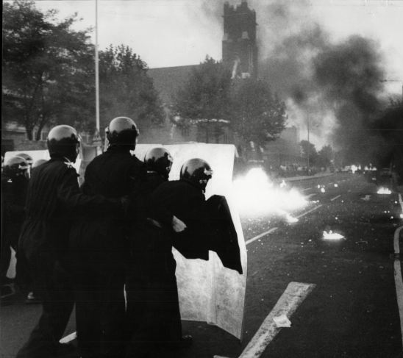
Homework:
The 1985 Brixton Uprising
1985 Brixton Uprising: Michael Groce
Michael grew up in Brixton, and the shooting of Michael's mother by a police officer helped spark the Uprising in 1985. The police officers were searching for Michael at the time. Today, Michael is a community worker and poet. He has written poetry reflecting on his upbringing in Brixton, including a number that reflect on the 1985 Uprising.
1985 Brixton Uprising: Chris Elliott
Chris was a young reporter working for the Daily Telegraph newspaper in 1985. He was sent as a reporter to cover the uprising. The photographer working with him on the night, David Hodge, died from injuries sustained that night. Chris went on to have a long career as a journalist, and has trained many journalists on ethical reporting.
Extension Task:
Do any of your family members remember the Brixton Uprisings of 1981 or 1985?
If they do ask them some questions about the Uprisings, and record their memories below:
Task: Watch the following interviews on the 1985 Uprising, and answer the following questions on the sheet.
Michael Groce Interview:
https://www.youtube.com/watch?v=6QUTjkDBGU8 (or search ‘Brixton Michael Groce’ on YouTube)
Chris Elliott Interview:
https://www.youtube.com/watch?v=87JZWEyHkUc (or search ‘Brixton Chris Elliott’ on YouTube)
1. How did Michael react to the news his mother had been shot?
2. Why were the police searching for Michael?
3. How did Michael feel about the police?
4. Who in the local community joined in with the uprising?
5. What does Michael see as the legacy of the project?
1. What was Chris’ experience of the uprising?
2. How did people react to Chris on the night?
3. In what ways have Chris’ perceptions of the uprising changed?
4. Why was it such an ‘overwhelming’ experience for Chris?
5. Why does Chris believe the reporting of the events were biased?

